Slide 1

Conducting a Systematic literature Review
Presenter: Zandile Mboneni

Slide 2

By the end of this session, you will:
Understand what a systematic literature review is
Learn the steps of conducting an SLR
Practice searching and screening literature
Understand data extraction and synthesis

Slide 3

Why Literature Reviews Matter?
Literature reviews help researchers:
Identify knowledge gaps
Avoid duplication
Understand previous findings
Develop research questions

Slide 4
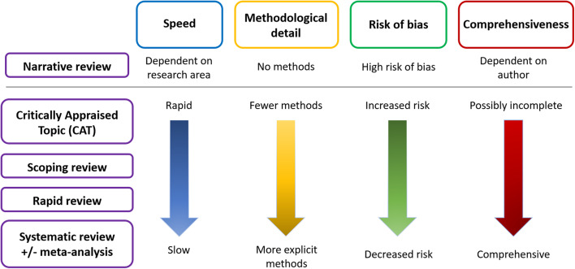
Types of literature reviews

Slide 5

What is a Systematic Literature Review?
A Systematic Literature Review is a structured research approach used to locate, evaluate, and synthesise existing studies related to a specific research question. It provides a comprehensive overview of the current state of knowledge in a field and helps identify research gaps for future investigation (Carrera-Rivera et al. 2022).

Slide 6

When should you use an SLR?

Slide 7

Overview of the SLR process:
Define research question
Develop protocol
Search literature
Screen studies
Extract data
Assess quality
Synthesise findings

Slide 8
Step 1: Define research question
Researchers often use structured frameworks such as PICO and SPIDER to formulate research questions.

Slide 9
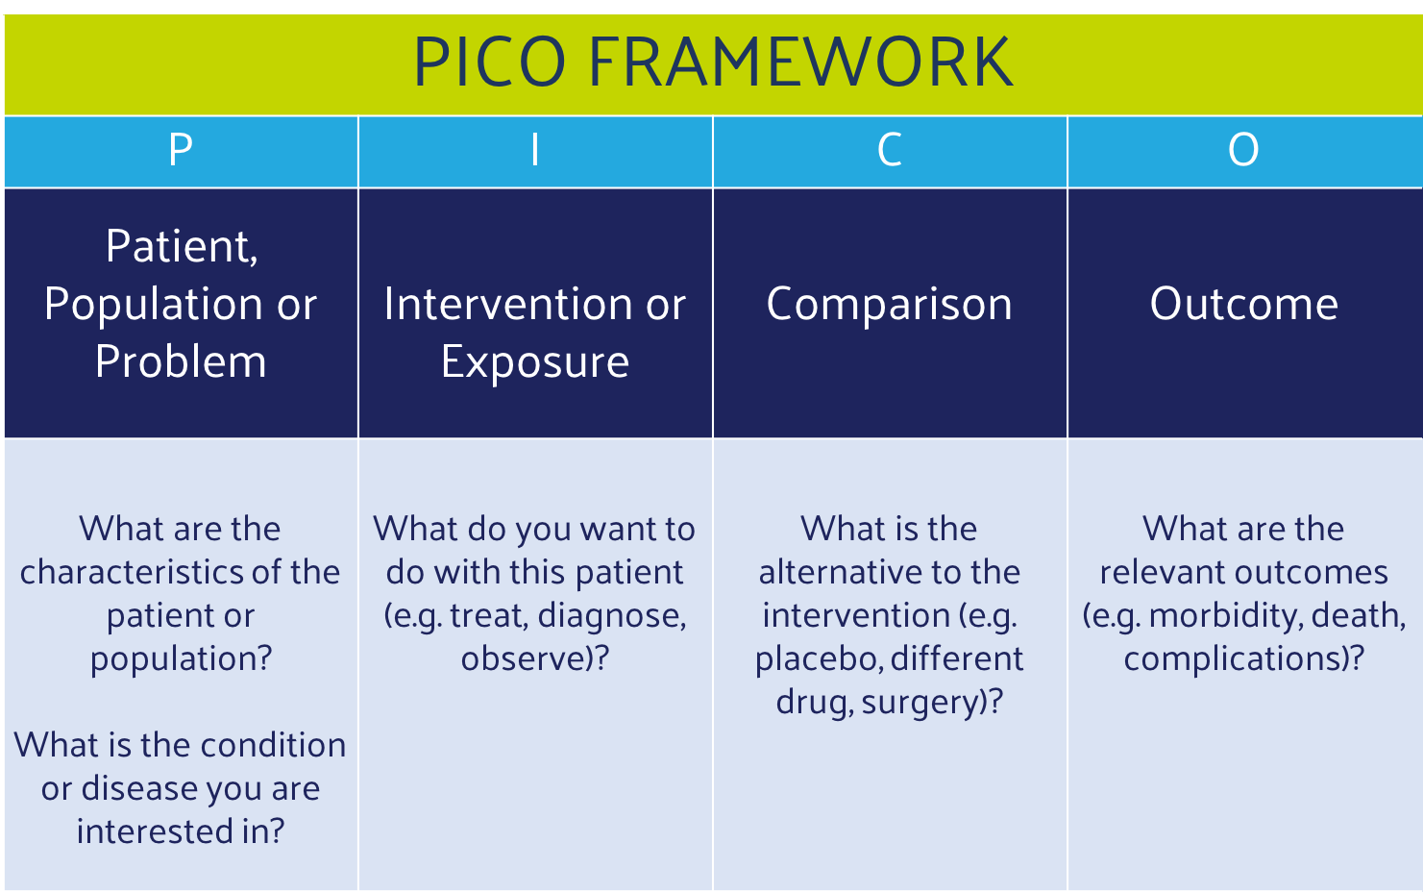

Slide 10
Example:
What is the effect of lightweight AI models on mobile plant disease detection accuracy compared with traditional deep learning models in South African agriculture?
Notes:
P = Plant disease detection systems in South African agriculture; I = Lightweight AI models; C = Traditional deep learning models; O = Detection accuracy and mobile deployment efficiency

Slide 11
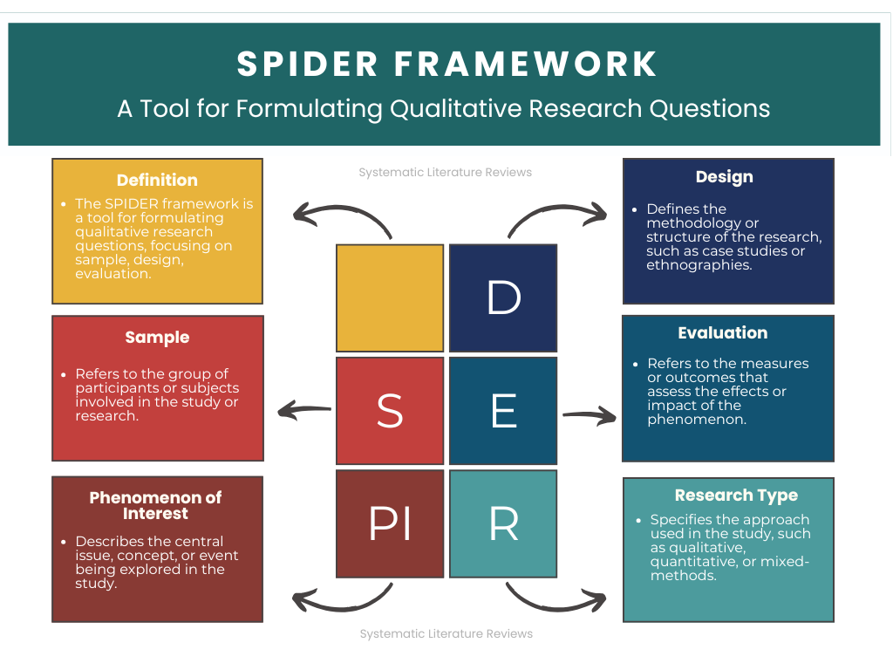

Slide 12
Example:
How do farmers and agricultural practitioners experience the use of mobile AI applications for plant disease detection in South African agriculture?
Notes:
S = Farmers and agricultural practitioners; PI = Mobile AI applications for plant disease detection; D = Case study; E = user experiences; R = Qualitative

Slide 13

Activity!
Pick a topic you would like to research, then use PICO or SPIDER to formulate your research question.

Slide 14
Step 2: Develop a Review Protocol
A review protocol includes:
Research question
Search strategy
Databases
Inclusion criteria
Exclusion criteria
Data extraction plan

Slide 15
Step 3: Searching Databases
Create a search string using Boolean operators (AND, OR, NOT)
Select 3 to 5 databases (e.g., Scopus, Web of Science, Academic Search Premier (EBSCOhost)

Slide 16
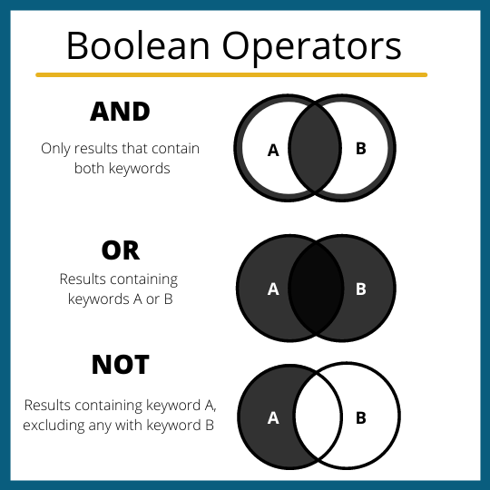

Slide 17
Example:
How do farmers and agricultural practitioners experience the use of mobile AI applications for plant disease detection in South African agriculture?
Key concept:
Farmers and agricultural practitioners
Mobile AI applications
Plant disease detection
Experience
Keywords/Synonyms:
farmers, agricultural workers, crop specialists
mobile AI, smartphone applications, edge AI, mobile applications
crop disease detection, plant disease diagnosis
perception, usability, attitude, challenges

Slide 18
Search String Example:
(farmer* OR "agricultural practitioner*" OR "agricultural worker*" OR "crop specialist*") AND ("mobile AI" OR "smartphone application*" OR "edge AI" OR "mobile application*") AND ("plant disease detection" OR "crop disease detection" OR "plant disease diagnosis" OR "crop disease diagnosis") AND (experience* OR perception* OR usability OR challenge*)

Slide 19

Activity!
From your formulated research question:
Identify key concepts and find synonyms and related terms
Create a search string

Slide 20
Step 4: Screening Articles
Stages:
Remove duplicates
Title screening
Abstract screening
Full-text screening

Slide 21
Step 4: Screening Articles (Inclusion & Exclusion Criteria)
Inclusion Criteria
Inclusion criteria define the characteristics that studies must have to be included in the review.
Examples:
Studies focusing on online learning in higher education
Studies involving university students
Peer-reviewed journal articles
Articles published between 2015–2024
Studies written in English
Exclusion Criteria
Exclusion criteria specify which studies should not be included.
Examples:
Studies focusing on primary or secondary school students
Opinion papers or editorials
Non-English publications
Studies not related to online learning experiences

Slide 22

Activity!
Formulate your inclusion and exclusion criteria

Slide 23
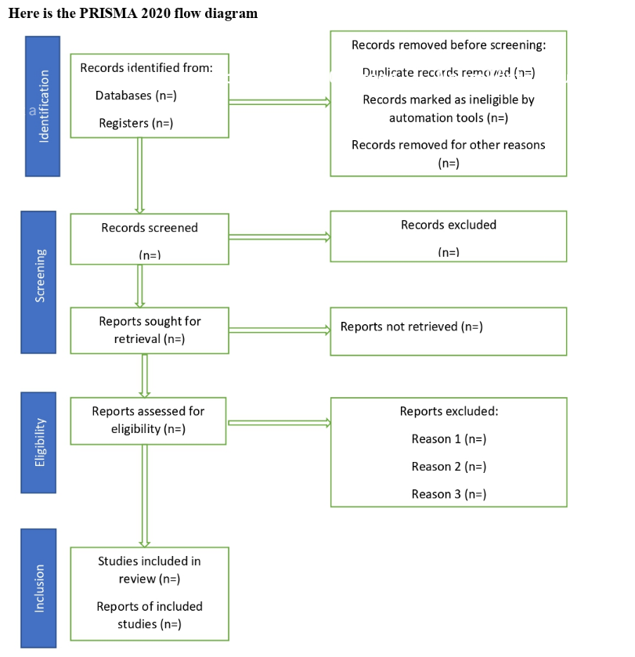

Slide 24
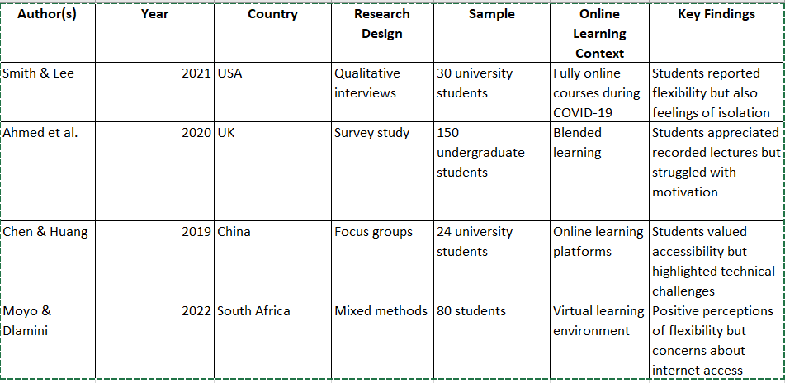
Step 5: Data Extraction

Slide 25
Step 6: Quality Assessment
Assess study quality by considering:
Research design
Bias
Sample size
Validity of results

Slide 26
Quality Assessment Tool Selection Matrix
Tool | Quantitative (Experimental / Trials) | Quantitative (Surveys / Observational) | Qualitative (Interviews / Case Studies) | Mixed-Methods / Multi-Method | Focus of Appraisal
Cochrane (RoB 2 / ROBINS-I) | Excellent | Good | No | No | Strictly evaluates internal validity and statistical risk of bias.
JBI Checklists | Excellent | Excellent | Excellent | No | Evaluates methodological trustworthiness via study-specific checklists.
CASP | Good | Good | Excellent | No | Evaluates validity, results, and utility using simple 10-question formats.
MMAT | Good | Good | Good | Excellent | Evaluates combination and integration of qualitative and quantitative data.
GRADE | N/A | N/A | N/A | N/A | Evaluates the entire body of evidence together, not individual studies.

Slide 27
Step 7: Synthesise findings
Two main methods:
Narrative synthesis
Describing patterns across studies
Meta-analysis
Statistical combination of results

Slide 28
The end!

